Slide 1

PKI
On
Windows Server 2012 R2
From Scratch
PKI
On
Windows Server 2012 R2
From Scratch
Notes:
Presentation: 90 minutes
Lab: 60 minutes
After completing this module, students will be able to:
Implement Domain Name System (DNS) servers.
Configure zones in DNS.
Configure DNS integration with Active Directory Domain Services (AD DS).
Configure DNS resolution between zones.
Configure advanced DNS settings.
Required materials
To teach this module, you need the Microsoft PowerPoint file named 10970B_02.pptx.
Important: It is recommended that you use PowerPoint 2013, PowerPoint 2010, or PowerPoint 2007 to display the slides for this course. If you use a different version of PowerPoint or you use PowerPoint Viewer, the features of the slides might not all display correctly.
Preparation tasks
To prepare for this module:
Read all the materials for this module.
Practice performing the demonstrations and the lab exercises.
Work through the Module Review and Takeaways section, and determine how you will use that section to both reinforce student learning and promote knowledge transfer to on-the-job performance.
10970B
2: Implementing Name Resolution by Using DNS

Slide 2
Sections at a Glance
Overview of PKI
Overview of Cryptography
Certification Authority or CA
Certificate Requests or Enrollment
Configuring CA properties
New Features of CA in Windows Server 2008 and onwards
Notes:
10970B
2: Implementing Name Resolution by Using DNS

Slide 3
Overview of PKI

Slide 4
What Is a PKI?
The combination of software, encryption technologies, processes, and services that enables an organization to secure its communications and business transactions
Requirement | PKI solutions
Confidentiality | Data encryption
Integrity | Digital signatures
Authenticity | Hash algorithms, message digests, digital signatures
Nonrepudiation | Digital signatures, audit logs
Availability | Redundancy

Slide 5
Uses of PKI?
Client Server Authentication
Signatures –
Drivers Signing
Emails
Tokens – ADFS
Web Traffic (HTTPS)
Encryption (Network Data, IPSec, EFS)
Wireless
Smart Cards
Notes:
Discuss as follows:
Define PKI.
How does PKI provide infrastructure security by providing confidentiality, integrity, authenticity, and non-repudiation.

Slide 6


















Components of a PKI Solution
CA
Digital Certificates
Certificate Templates
CRLs and Online Responders
Public Key–Enabled Applications and Services
Certificates and CA Management Tools
AIA and CDPs
Notes:
Briefly describe each component of the PKI solution. Do not spend too much time on this topic, because you will discuss most of these components later in more detail. The purpose of this topic is to provide the students with a high-level overview of components that make up a PKI solution.
20412D
6: Implementing AD CS

Slide 7

What Is a Digital Certificate?
A digital certificate:
Verifies the identity of a user, computer, or program
Contains information about the issuer and the subject
Is signed by a CA

Slide 8
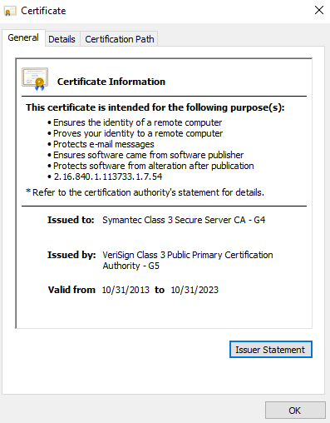
What Is a Digital Certificate?

Slide 9
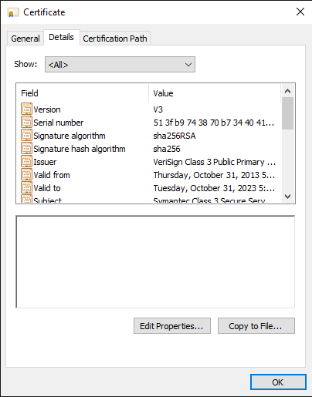
What Are Certificate Extensions?
Certificate extensions:
Provide additional information about the subject
Contain both version 1 and version 3 fields

Slide 10
Overview of Cryptography

Slide 11
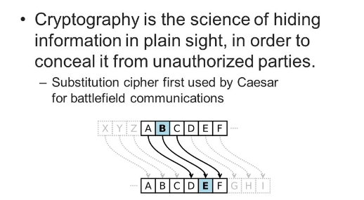

What Cryptography is all about
The art of protecting secrets using ciphers & codes.

Slide 12



Exchanging Secret Messages
tsl'g fdks d cssn
t = l
s = e
l = t
g = s
f = h
d = a
k = v
s = e
d = a
c = b
s = e
s = e
n = r

Slide 13



Encryption Keys
Key type | Description
Symmetric | Same key is used to encrypt and decrypt the data It protects the data from interception
Asymmetric | It consists of a public and private key The private key is protected, the public key is widely distributed If the private key is used to encrypt data, the public key is used to decrypt data, and vice versa

Slide 14



How Does Symmetric Encryption Work?
Original Data
Cipher Text
Original Data
Symmetric encryption:
Uses the same key
Is often referred to as bulk encryption
Is vulnerable if the symmetric key is obtained

Slide 15









How Does Public Key Encryption Work?
Requirement | Process
 | 1. The recipient’s public key is retrieved
 | 2. The data is encrypted with a symmetric key
 | 3. The symmetric key is encrypted with the recipient’s public key
 | 4. The encrypted symmetric key and encrypted data are sent to the recipient
 | 5. The recipient decrypts the symmetric key with her private key
 | 6. The data is decrypted with the symmetric key

Slide 16
Encryption Algorithms Cont..
DES This is the 'Data Encryption Standard'. This is a cipher that operates on 64-bit blocks of data, using a 56-bit key. It is a 'private key' system.
Triple DES
3 DES was designed to replace the original (DES) algorithm, which hackers eventually learned to defeat with relative ease. At one time, Triple DES was the recommended standard and the most widely used symmetric algorithm in the industry.
Triple DES uses three individual keys with 56 bits each. The total key length adds up to 168 bits,

Slide 17
Encryption Algorithms Cont..
RSA
RSA is a public-key encryption algorithm and the standard for encrypting data sent over the internet using key sizes 1,024 to 4,096 bit. It also happens to be one of the methods used in our PGP and GPG programs.
Unlike Triple DES, RSA is considered an asymmetric algorithm due to its use of a pair of keys.
Blowfish
Blowfish is yet another algorithm designed to replace DES. This symmetric cipher splits messages into blocks of 64 bits and encrypts them individually using key size of 32 – 448 bits
Mostly used in e-commerce to secure payment systems.
known for both its tremendous speed and overall effectiveness as many claim that it has never been defeated

Slide 18
Encryption Algorithms
AES
The Advanced Encryption Standard (AES) is the algorithm trusted as the standard by the U.S. Government and numerous organizations.
Although it is extremely efficient in 128-bit form, AES also uses keys of 192 and 256 bits for heavy duty encryption purposes.

Slide 19
What is Digital Signature
Digital Signature Ensures:
Verifies the identity of Author
Content is not modified during transit
All Certificates issued are signed by respective Certification Authority in the hierarchy

Slide 20
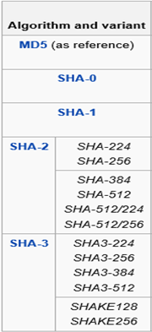
Hashing Algorithms
Hashing means “fingerprints” of data

Slide 21

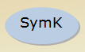


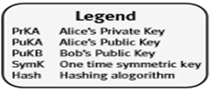
Example of Encryption and Signing
Alice sending a signed and encrypted message to Bob
1. Calculate Digest
2. Sign Digest
3. Evaluate SymK
4. Encrypt With SymK
5. Encrypt Symmetric Key
6. Send Message to Bob

Slide 22
Decryption and Verifying Message
Bob Decrypting and Verifying message sent by Alice
Decrypt SymK with PrKB
Decrypt Message with SymK
Evaluate Digest
Decrypt Digest using PuKA
Compare Digest
Message is decrypted and signature is verified

Slide 23
Certification Authority or CA

Slide 24
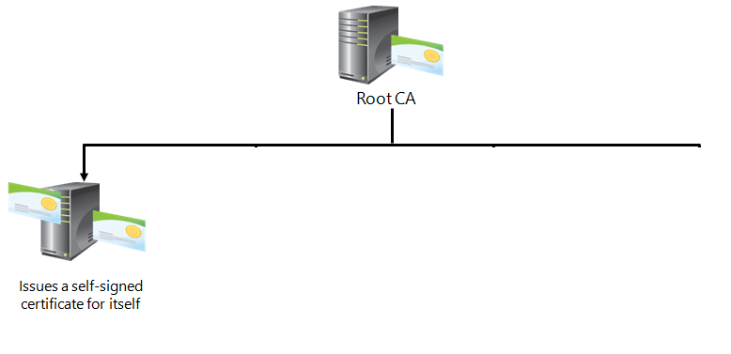
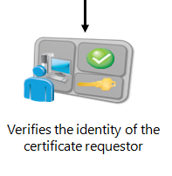
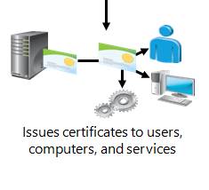
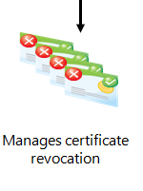
What Are CAs?
Notes:
Explain what a CA is, and how it operates. CAs are the key components of the PKI environment. In a simple PKI environment, a single CA may provide all of the PKI services.
20412D
6: Implementing AD CS

Slide 25










Overview of the AD CS Server Role in Windows Server 2012
CA
CA Web enrollment
Client
Online Responder
NDES
Enrollment
Firewall
CES
Client
Proxy
CEP
Client
Policy
Notes:
Introduce AD CS, and explain the purpose of each role service. Spend some time describing the role services that are new to Windows Server 2008 R2 and Windows Server 2012.
20412D
6: Implementing AD CS

Slide 26
Public vs. Private CAs
Internal private CAs:
Require greater administration than external public CAs
Cost less than external public CAs, and provide greater control over certificate management
Are not trusted by external clients by default
Offer advantages such as customized templates and autoenrollment
External public CAs:
Are trusted by many external clients
Have slower certificate procurement
Notes:
Start by explaining that you can implement a CA solution as an internal private CA. Alternatively, an organization can use an external public CA. Many organizations use both: an external public CA for their public-facing services, and an internal private CA for their internal corporate requirements.
You can also discuss a newer approach that some organizations use, the hybrid approach. In this scenario, the root is an externally trusted root CA, and internal CAs that issue certificates are subordinates. With the hybrid approach, companies can issue certificates that are trusted by virtually all computers. This module goes into more detail about this method in the following topics. Therefore, keep the discussion at a high level at this point, because subsequent topics provide more detail.
Remind the students that virtually all modern computers and applications trust a public CA, while an internal private CA is usually not trusted outside of the company that runs it. Mention that some organizations might choose to define their own list of trusted CAs. Ask the students which type of CA they are using in their environments today, and what its limitations are.
20412D
6: Implementing AD CS

Slide 27





Types of Certification Authorities
Root CA
Is the most trusted type of CA in a PKI infrastructure
Is a self-signed certificate
Issues certificates to other subordinate CAs
Possesses physical security and the certificate issuance policy that are typically more rigorous than subordinate CAs
Subordinate CA
Is issued by another CA
Addresses specific usage policies, organizational or geographical boundaries, load balancing, and fault tolerance
Issues certificates to other CAs to form a hierarchical PKI infrastructure
Notes:
Discuss:
Root and Subordinate CAs. Stress the need to protect the Root CA, since trusted Root CA automatically trusts every subordinate CA that has a valid CA certificate in the hierarchy.
Reasons for deploying a subordinate CA.
2. Source information:
Active Directory® Certificate Services Help: Public Key Infrastructures

Slide 28

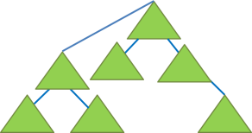
















Stand-Alone vs. Enterprise CAs
Stand-alone CAs |  | Enterprise CAs
 | Must be used if any CA (root/intermediate/policy) is offline, because a stand-alone CA is not joined to an AD DS domain |  | Requires the use of AD DS
 |  |  | Can use Group Policy to propagate certificate to trusted root CA certificate store
 | Users provide identifying information and specify type of certificate |  | Publishes user certificates and CRLs to AD DS
 | Does not require certificate templates |  | Issues certificates based upon a certificate template
 | All certificate requests are kept pending until administrator approval |  | Supports autoenrollment for issuing certificates
Notes:
Discuss the following:
Stand-alone and enterprise CAs, and the differences between the two.
CAs that issue certificates to clients over the Internet.
The typical configuration of a root CA as a stand-alone CA.
Mention that business requirements often dictate the type (or types) of CAs that the students will use. For example, autoenrollment requires an enterprise CA.
20412D
6: Implementing AD CS

Slide 29
Considerations for Deploying a Root CA
Computer name and domain membership cannot change
When you plan private key configuration, consider the following:
CSP or KSP
Key character length with a default of 2,048
The hash algorithm that is used to sign certificates issued by a CA
When you plan a root CA, consider the following:
Name and configuration
Certificate database and log location
Validity period
Notes:
Describe the key points related to considerations for installing a root CA. When you discuss the private key configuration, mention that any provider that starts with a number sign (#) in its name is a Cryptography Next Generation (CNG) provider.
Windows Server 2008 and Windows Server 2012 enhance CNG, which Windows Vista® first introduced. The CNG application programming interface (API) is the long-term replacement for the Cryptography Application Programming Interface (Crypto API) in older versions of the Windows operating system.
20412D
6: Implementing AD CS

Slide 30


Considerations for Deploying a Subordinate CA
Root
Root
Subordinate
Subordinate
S/MIME
EFS
RAS
India
Canada
USA
Certificate Uses
Locations
Root
Root
Subordinate
Subordinate
Employee
Contractor
Partner
Load Balancing
Organizational Divisions
Notes:
Discuss scenarios for deploying a subordinate CA. Ask the students if they have PKI deployed in their environments, and whether they use only root CAs, or if they have also deployed subordinate CAs as well.
20412D
6: Implementing AD CS

Slide 31


What Is a Cross-Certification Hierarchy?
Cross-Certification at the Root CA Level
Root CA
Root CA
Subordinate CA
Subordinate CA
Organization 1
Organization 2
Cross-Certification Subordinate CA to Root CA
Root CA
Root CA
Subordinate CA
Subordinate CA
Organization 1
Organization 2
Notes:
Explain the following benefits of a cross-certification hierarchy:
It provides an approach for one CA hierarchy to trust another CA hierarchy.
It provides interoperability PKI between networks or other organizations (mergers, acquisitions, partnerships).
It assumes complete trust of a foreign CA hierarchy.
It can be configured at the root CA level or at the subordinate-to-the-root CA level.
Question
Your company is currently acquiring another company. Both companies run their own PKI. What could you do to minimize disruption and continue to provide PKI services seamlessly?
Answer
You could implement a cross-certification hierarchy.
20412D
6: Implementing AD CS

Slide 32
Demonstration: Deploying a Root CA and Subordinate CA
In this demonstration, you will see how to -
Deploy an Standalone Root CA on Windows Server 2016
Deploy an Enterprise Subordinate Ca on Windows Server 2016
Notes:
When you have completed the demonstration, leave the virtual machines running for the subsequent demonstrations.
Preparation Steps
This demonstration is mandatory to perform, because it establishes the PKI and CA that you will use in the following demonstrations in this module.
For this demonstration, start 20412D-LON-DC1 and 20412D-LON-SVR1. Sign in to both virtual machines as Adatum\Administrator with the password Pa$$w0rd.
Demonstration Steps
Deploy a root CA
On LON-SVR1, in the Server Manager, click Add roles and features.
On the Before You Begin page, click Next.
On the Select installation type page, click Next.
On the Select destination server page, click Next.
On the Select server roles page, select Active Directory Certificate Services. In the Add Roles and Features Wizard, click Add Features, and then click Next.
On the Select features page, click Next.
On the Active Directory Certificate Services page, click Next.
On the Select role services page, ensure that Certification Authority is selected, and then click Next.
On the Confirm installation selections page, click Install.
On the Installation progress page, after the installation completes successfully, click the text Configure Active Directory Certificate Services on the destination server.
20412D
6: Implementing AD CS

Slide 33
Migrating Hashing Algorithm from SHA1 to SHA2
Windows are no longer trusting certificates signed with SHA-1 after January 1, 2017. (Applicable on External Certificates)
Windows 2008 and onwards CA supports SHA-2
Before migrating to SHA-2, thoroughly check all applications if they support SHA-2 signed certificates.
CSP doesn’t support SHA-2, have to switch CA key to KSP

Slide 34
Migrating Hashing Algorithm from SHA1 to SHA2 (Root CA)
Backup CA and CA registry key
Stop CA service
Check if CA is using CSP or KSP
If using HSM for storing certificate key, please check with HSM vendor for steps on migrating from CSP to KSP (Optional)
Delete CA certificate along with private key from local machine store
Migrate CA certificate and private key from CSP to KSP (this step is optional but has to be done on windows server 2012 R2)
Import CA certificate in the machine store
Import modified configuration and encryption registry file into machine registry
Changing Hashing algorithm from SHA1 to SHA2
Start CA service
Renew CA certificate
Run CERTUTIL –CRL to generate a new CRL signed with SHA-2 certificate

Slide 35
Migrating Hashing Algorithm from SHA1 to SHA2 (Sub CA)
Backup CA and CA registry key
Stop CA service
Check if CA is using CSP or KSP
If using HSM for storing certificate key, please check with HSM vendor for steps on migrating from CSP to KSP (Optional)
Delete CA certificate along with private key from local machine store
Migrate CA certificate and private key from CSP to KSP (this step is optional but has to be done on windows server 2012 R2)
Import CA certificate in the machine store
Import modified configuration and encryption registry file into machine registry
Changing Hashing algorithm from SHA1 to SHA2
Start CA service
Publish RootCA new CRL and certificate
Renew CA certificate by requesting offline from Root CA
Run CERTUTIL –CRL to generate a new CRL signed with SHA-2 certificate

Slide 36
Certificate Request
or
Enrollment

Slide 37
Types of Certificate Enrollment
Web enrollment
MMC
Auto enrollment
Certreq.exe or offline Request
Certificate Enrollment Policy (CEP) – New in server 2008 R2
Certificate Enrollment Service (CES)- New in Server 2008R2
Notes:
Certreq.exe -new <RequestPolicy.inf><CertificateRequest.req>
certreq -submit -config "<ServerName\CAName>" "<CertificateRequest.req>" "<CertificateResponse.cer>“
certreq –retrieve -config "<ServerName\CAName>" <RequestID> "<CertificateResponse.cer>

Slide 38
What Are Certificate Templates?
A certificate template defines:
The format and contents of a certificate
The process for creating and submitting a valid certificate request
The security principals that are allowed to read, enroll, or use autoenrollment for a certificate that will be based on the template
The permissions required to modify a certificate template
Notes:
You should start by defining a certificate. Ask the students to provide their definition of a certificate. After that, start to introduce templates. A set of default templates is included during the installation of AD CS. Explain that the students can duplicate and modify these default templates to meet business requirements. You will discuss specific template versions and features in later topics. Also, emphasize that in Windows Server 2008 R2, the Standard edition operating system also works with certificate templates.
20412D
6: Implementing AD CS

Slide 39
Certificate Template Versions in Windows Server 2012
Version 1:
Introduced in Windows 2000 Server, provides for backward compatibility in newer versions
Creates by default when a CA is installed
Cannot be modified (except for permissions) or removed, but can be duplicated to become version 2 or 3 templates, which can then be modified
Version 2:
Default template introduced with Windows Server 2003
Allows customization of most settings in the template
Several preconfigured templates are provided when a CA is installed
Version 3:
Supports advanced Suite B cryptographic settings
Includes advanced options for encryption, digital signatures, key exchange, and hashing
Only supports Windows Server 2008 and Windows Server 2008 R2 servers
Only supports Windows Vista and Windows 7 client computers
Version 4:
Available only for Windows Server 2012 and Windows 8 clients
Supports both CSPs and KSPs
Supports renewal with the same key
Notes:
Discuss certificate template versions, and the functional differences between them.
20412D
6: Implementing AD CS

Slide 40
WEB Enrollment
Domain joined and NON-Domain clients can request certificates using web enrollment.
Need to access http://certservername/certsrv
Allow you to download CA chain certificate
Allow you to view the pending request

Slide 41
Requesting certificate via MMC
Only domain joined clients able to request certificate via MMC console.

Slide 42
Requesting certificate via Certreq: Offline Request
Certreq.exe -new <RequestPolicy.inf><CertificateRequest.req>
certreq -submit -config "<ServerName\CAName>" "<CertificateRequest.req>" "<CertificateResponse.cer>“
certreq –retrieve -config "<ServerName\CAName>" <RequestID> "<CertificateResponse.cer>“
certreq –accept -config "<ServerName\CAName>" "<CertificateResponse.cer>"

Slide 43









Requesting a Certificate using Autoenrollment
A certificate template is configured to Allow, Enroll, and Autoenroll permissions for users who receive the certificates
Certificate template
The CA is configured to issue the template
CA
An Active Directory Group Policy Object should be created to enable autoenrollment. The GPO should be linked to the appropriate site, domain, or organizational unit
Group Policy Object
The client machine receives the certificates during the next Group Policy refresh interval
Client machine
Notes:
Discuss the following:
Autoenrollment enables organizations to deploy public key–based certificates to users and computers automatically.
Domain members using the Windows® XP operating system, Windows Server 2003, or newer versions can use certificate autoenrollment.
The Certificate Services administrator can allow Enroll and Autoenroll permissions, and configure templates for users who receive certificates.
Domain-based Group Policy activates and manages autoenrollment. Both computer-based and user-based Group Policy can activate autoenrollment. By default, Group Policy is applied at the restart for computers, or at logon for users, and is refreshed periodically. The Group Policy setting is named Certificate Services Client - AutoEnrollment.
An internal timer triggers autoenrollment every eight hours after previous autoenrollment activation. For each request that requires user interaction as per the certificate template, a pop-up window displays approximately 60 seconds after logon. If no user interaction occurs on the certificate template, no window displays.
You may want to expand upon certificate usage with Group Policy, as covered in the workbook—that is, enhancements in Windows Server 2008, the benefits of deploying via Group Policy, and other features.
You also may want to discuss autoenrollment briefly from the perspectives of CA options or certificate templates.
Finally, be sure to discuss Credential Roaming.
20412D
6: Implementing AD CS

Slide 44
CA Policy and Exit Modules
The policy module determines the action that is performed after the certificate request is received
The exit module determines what happens with a certificate after it is issued
Each CA is configured with default policy and exit modules
The FIM CM 2010 deploys custom policy and exit modules
The exit module can send email or publish a certificate to a file system
You have to use certutil to specify these settings, as they are not available in the CA administrator console
https://msdn.microsoft.com/en-us/library/aa388216.aspx
Notes:
Define policy and exit modules on the CA. Most of the students will not be familiar with these settings, as they are used rarely. Use FIM CM to provide real-life examples of custom policy and exit modules. Spend some time explaining how to configure default exit modules to perform certain tasks.
20412D
6: Implementing AD CS

Slide 45
Hands-On:
. Encrypting and Decrypting a File with Certificate

Slide 46

Hands On: Securing a website using a Certificate

Slide 47
Configuring CA Properties

Slide 48
Configuring CA Administration and Security
You can establish role-based administration for the CA hierarchy by defining the following roles:
CA administrator
Certificate manager
Backup operator
Enrollees
You can assign the following permissions on the CA level:
Read
Issue and Manage Certificates
Manage CA
Request Certificates
Notes:
Define and discuss role-based administration for the CA hierarchy. Discuss each role and its rights and permissions. Explain the relationship between role-based administration and security permissions that are defined on the CA level.
20412D
6: Implementing AD CS

Slide 49
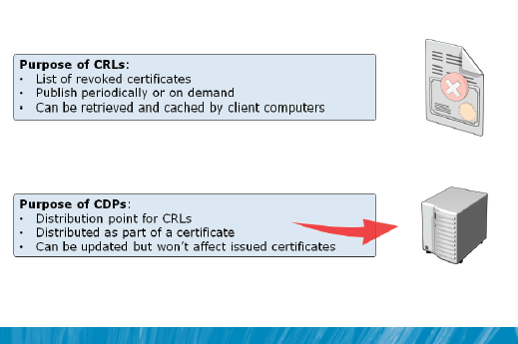
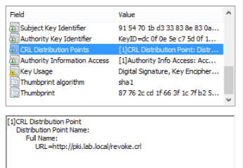
What are CRLs and CDPs

Slide 50




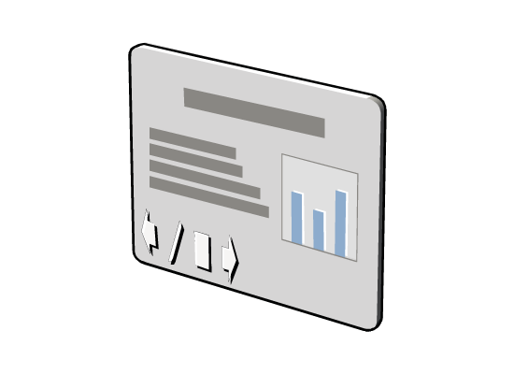



Type of CRLs
Base CRLs
+
All revoked
certificates
Lesser publication interval
Large size
Client computer using
any version of Windows®
Delta CRLs
-
Last base CRL
certificate
Greater publication interval
Small size
Client computer using
Windows XP® or
Windows Server® 2003
Notes:
Describe base and delta CRLs.

Slide 51




How CRLs Are Published
Delta CRL# 2
Delta CRL# 3
Cert5
Cert7
Cert5
Revoke
Cert5
Revoke
Cert7
Time
Cert3
Cert3
Cert5
Cert7
Base CRL# 1
Base CRL# 2
Notes:
Describe the following process:
Each CA is configured with a CRL publication setting or CRL publish period. The CRL publish period defines when a CA will automatically publish an updated CRL. When a CA is first installed, the publish period is set to one week, but you can configure it manually.
CRLs are published in the following sequence:
The initial base CRL (CRL#1) is published with one revoked certificate.
Soon after, Cert5 is revoked.
When the delta CRL (CRL#2) is published, the delta CRL includes Cert5.
A second certificate, Cert7, is revoked.
When the updated delta CRL (CRL#3) is published, the delta CRL now contains Cert5 and Cert7.
Finally, when the base CRL is published, the base CRL (CRL#4) includes the serial numbers for Cert3, Cert5, and Cert7.
Any new delta CRLs will now include only certificates that have been revoked since base CRL#4 was issued.

Slide 52
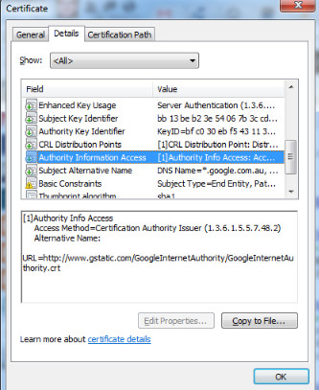
Authority Information Access or AIA Extension
Authority information access locations:
Authority information access locations are URLs that are added to a certificate in its authority information access extension. These URLs can be used by an application or service to retrieve the issuing CA certificate. These CA certificates are then used to validate the certificate signature and to build a path to a trusted certificate.

Slide 53



Considerations for Publishing AIAs and CDPs
Publish the root certificate CA and URL to:
AD DS
Web servers
FTP servers
File servers
Offline
Root CA
External Web server
FTP server
AD DS
Firewall
Firewall
Internet
Internal Web server
File server
Notes:
Be sure to explain what AIA and CDP are, and the purpose of these certificate extensions. After that, discuss publication points and usage scenarios.
Explain to students that after you install a root CA, you need to configure two X.509 version 3 extension fields, known as the AIA and the CDP extensions. These extensions apply to all certificates that the root CA issues. These extensions define where client applications can find valid AIA and CDP information for the root CA.
Inform the students that the formatting and publishing of AIA and CDP extension URLs are generally the same for root CAs and subordinate CAs. The difference between offline CAs and online CAs is that offline CAs require manual certificate and CRL publishing to a directory or Web server.
20412D
6: Implementing AD CS

Slide 54
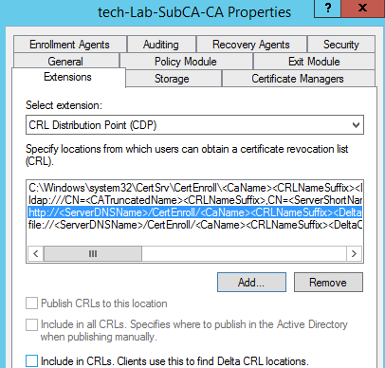
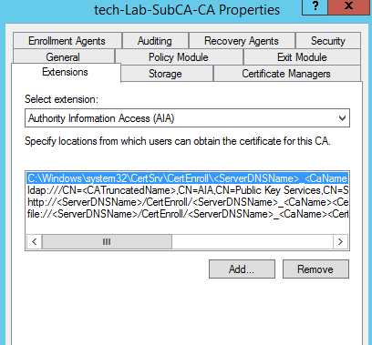
Configuring AIA and CDP extensions

Slide 55
New Roles in Certificate Services

Slide 56
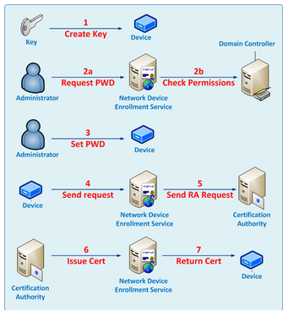
Network Device Enrollment Service
https://<ServerName>/certsrv/mscep_admin
Notes:
The Network Device Enrollment Service (NDES) is one of the role services of the Active Directory Certificate Services (AD CS) role. It implements the Simple Certificate Enrollment Protocol (SCEP). SCEP defines the communication between network devices and a Registration Authority (RA) for certificate enrollment
1. Network Device must be configured with the password obtained from NDES. Administrator can retrieve the password from NDES at https://<ServerName>/certsrv/mscep_admin.
2. While sending the enrollment request, the KeyUsage extension is defined in the request.
The KeyUsage extension value usually defaults to 0xa0 for most devices.
0x80: Uses the template name identified in the "SignatureTemplate" registry key
0x20: Uses the template name identified in the "EncryptionTemplate" registry key.
0xa0: Uses the template name identified in the "GeneralPurposeTemplate" registry key.

Slide 57
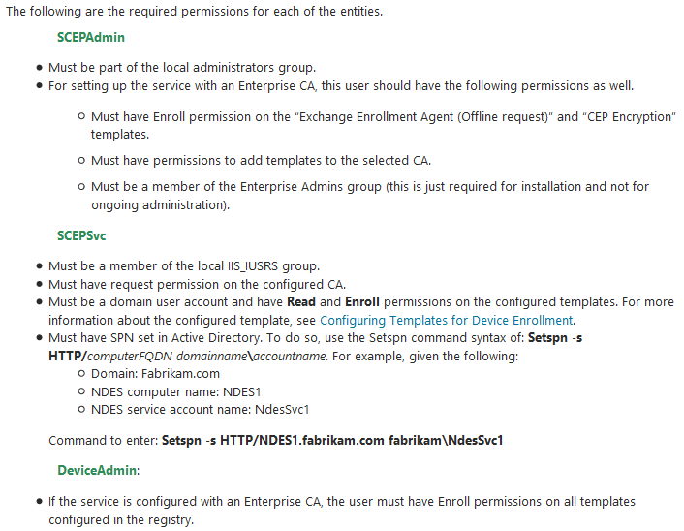
Hands On: Configuring NDES
Pre-requisite for NDES installation
Notes:
Two VD created in NDES:
http://localhost/certsrv/mscep Devices use this location for all communication.
http://localhost/certsrv/mscep_admin Administrators use this location to retrieve enrollment passwords.
The service uses two certificates for two different scenarios.
Enrollment agent certificate This certificate will be used to send the enrollment request to the CA.
Key Exchange certificate This certificate will be used by the device to encrypt all the communication with the service (essential for transmitting the password).

Slide 58
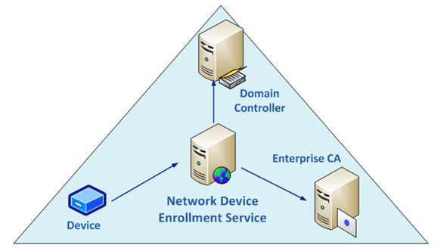
Hands On: Configuring NDES

Slide 59
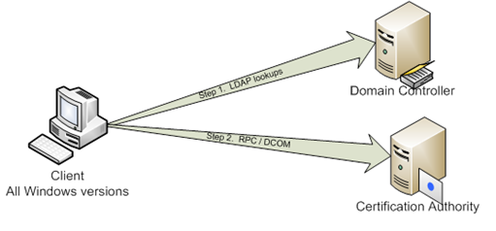
Certificate enrollment without CEP / CES
Notes:
Step 1. LDAP queries to a domain controller for a list of templates and enterprise CA’s.
Step 2. DCOM connection an Enterprise Certification Authority.
Limitations –
Computers in a DMZ network. Typically computers in a DMZ do not have access to internal corporate resources like domain controllers and CA’s because either they are in a workgroup or they belong to a DMZ forest with a one way trust in place. Non-domain joined workstations. They are unable to authenticate to a DC and perform the initial LDAP queries, and thus will never make it to step 2 - the RPC / DCOM call.

Slide 60
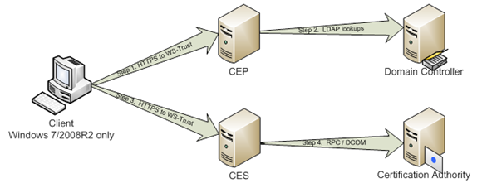
Certificate enrollment with CEP / CES
Notes:
Step 1. Client connects to the CEP web service over HTTPS.
The Windows 7 / Windows Server 2008R2 computer is configured to enroll for certificates against a CEP server. When a CEP server is configured in the environment the client will connect to the CEP server via port 443 (HTTPS), and connect to the CEP web service.
Administrators can configure via local / group policy what CEP server to use at the following locations:
Computer Configuration\Policies\Windows Settings\Security Policy\Public Key Policies\Certificate Services Client – Certificate Enrollment Policy
User Configuration\Policies\Windows Settings\ Security Policy\Public Key Policies\Certificate Services Client – Certificate Enrollment Policy
Step 2. – CEP web service queries LDAP.
Step 3. Client connects to the CES web service over HTTPS
msPKI-Enrollment-Servers is the attribute where you define CES servers URI.
On the client you need to configure CEP Server URI - https://<Internet FQDN>/ADPolicyProvider_CEP_UsernamePassword/service.svc/CEP
Step 4. CES web service impersonates the client security context to request a certificate via DCOM, and then hands the certificate back to the client.

Slide 61
Certificate Enrollment Service (CES)
CES is another web service that allows users and computers to perform certificate enrollment by using the HTTPS protocol.
Together with the CEP web service, CES enables policy-based certificate enrollment when the client computer is not a member of a domain or when a domain member is not connected to the domain.
CEP/CES also enables cross-forest policy-based certificate enrollment for Windows 7 or Windows Server 2008 R2 clients
CES role will require Kerberos delegation to be configured because it impersonates the user to the CA DCOM interface.

Slide 62
Certificate Enrollment Policy (CEP)
CEP is a web service that enables users and computers to obtain certificate enrollment policy information. This information includes what types of certificates can be requested and which CAs can issue them.
Only available on Windows Server 2008 R2 above and the only clients that are capable of requesting certificates via CEP and CES is Windows 7 and Windows Server 2008 R2 above
Roles can be used with Windows Server 2003, 2008, 2008R2 and 2012R2 Certification Authorities (CA).

Slide 63
Demonstration: Configuring CEP and CES
In this demonstration, you will see how to configure CES and CEP servers
Notes:
When you have completed the demonstration, leave the virtual machines running for the subsequent demonstrations.
Preparation Steps
For this demonstration, start 20412D-LON-DC1 and 20412D-LON-SVR1. Sign in to both virtual machines as Adatum\Administrator with the password Pa$$w0rd.
Be sure to complete all previous demonstrations before you start this demonstration.
Demonstration Steps
Configure an Online Responder
On LON-SVR1, on the taskbar, click the Server Manager icon.
In the Server Manager, click Add roles and features.
Click Next three times.
On the Select server roles page, expand Active Directory Certificate Services (1 of 6 installed), and then select Online Responder.
Click Add Features.
Click Next two times, and then click Install.
When the message displays that installation is successful, click Configure Active Directory Certificate Services on the destination server.
In the AD CS Configuration Wizard, click Next.
Select Online Responder, and then click Next.
Click Configure, and then click Close two times.
In the Server Manager console, click Tools, and then click the Certification Authority console on LON-SVR1.
In the Certification Authority console, right-click AdatumRootCA, and then click Properties.
20412D
6: Implementing AD CS

Slide 64






What Is an Online Responder?
 | Uses OCSP validation and revocation checking using HTTP
 | Receives and responds dynamically to individual requests
 | Supports only Windows Server 2008, Windows Vista, and newer Windows operating systems
 | Functions as a responder to multiple CAs
Notes:
Describe how an Online Responder uses Online Certificate Status Protocol (OCSP) to provide a more efficient method for clients to determine the revocation status of a certificate. OCSP uses HTTP for submitting certificate status requests.
Remind the students that using standard CRLs may be inefficient because of the size of the CRL, and that clients must check the entire CRL. An Online Responder does this checking process for the client, and responds only with the requested certificate.
Mention that the Online Responder can support a number of CAs, including a CA other than Microsoft.
20412D
6: Implementing AD CS

Slide 65


How OCSP works
CA
Clients
OCSP

Slide 66
Demonstration: Configuring an Online Responder
In this demonstration, you will see how to configure an Online Responder
Notes:
When you have completed the demonstration, leave the virtual machines running for the subsequent demonstrations.
Preparation Steps
For this demonstration, start 20412D-LON-DC1 and 20412D-LON-SVR1. Sign in to both virtual machines as Adatum\Administrator with the password Pa$$w0rd.
Be sure to complete all previous demonstrations before you start this demonstration.
Demonstration Steps
Configure an Online Responder
On LON-SVR1, on the taskbar, click the Server Manager icon.
In the Server Manager, click Add roles and features.
Click Next three times.
On the Select server roles page, expand Active Directory Certificate Services (1 of 6 installed), and then select Online Responder.
Click Add Features.
Click Next two times, and then click Install.
When the message displays that installation is successful, click Configure Active Directory Certificate Services on the destination server.
In the AD CS Configuration Wizard, click Next.
Select Online Responder, and then click Next.
Click Configure, and then click Close two times.
In the Server Manager console, click Tools, and then click the Certification Authority console on LON-SVR1.
In the Certification Authority console, right-click AdatumRootCA, and then click Properties.
20412D
6: Implementing AD CS

